Slide 1
Appendix E
Hashing

Slide 2
Hashing
In hashing, elements are stored in a hash table, and the location of each element in the table is determined by a hashing function.
Hashing operations are O(1) under the best of circumstances
The situation where two elements or keys map to the same location is the table is called a collision.
A hashing function that maps each element to a unique position in the table is called a perfect hashing function.
Two important properties of hash tables
initial capacity
load factor

Slide 3
Hashing Functions
Extraction involves using only a part of the element’s value or key to computer the location at which to store the element.
Division involves using the modulus of the value of the key by some positive integer. Hash_value = key % p. Make p a prime number.
In the folding method, the key is divided into parts that are then combined or folded together to create an index.
In shift folding method, the parts of the key are added together to create an index
Boundary folding is similar to shift folding except that some of the parts of the key are reversed
Folding can be used with strings by dividing the string into parts of equal bytes and then using an exclusive-or on the parts.

Slide 4
Hashing Functions
In the mid-squared method, the key is multiplied by itself, and then the extraction method is used to extract the appropriate number of digits from the middle of the squared result.
In the radix transformation method, the key is transformed into another numeric base. This index is often further modified using the division method.
In the digit analysis method, the index is formed by extracting, and then manipulating, specific digits from the key.
In the length-dependent method, the key and the length of the key are combined in some way to form either the index or an intermediate value that is then used with another method.

Slide 5
Hashing Functions
Strings
Many of the above methods may be used effectively with strings by manipulating the binary representation of the characters in the string.
Hashing Functions in the Java Language
The default hashcode method in java.lang.Object class uses the memory location of the object to create a hash.
It is often preferable to define a specific hashing function for a particular class.

Slide 6
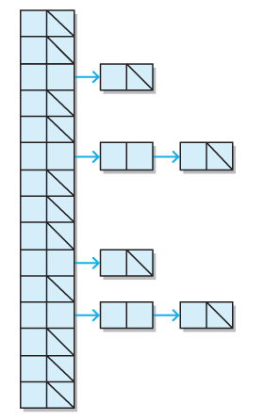
Resolving Collisions
The chaining method for handling collisions simply treats the hash table conceptually as a table of collections, rather than as a table of individual cells.

Slide 7
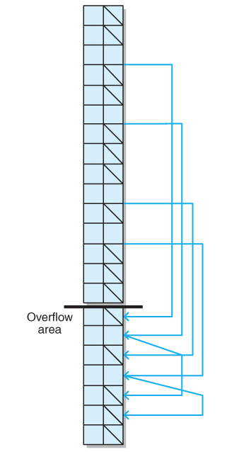
Resolving Collisions
Chaining with overflow
If either portion of hash table fills then we must resize both portions
A poor hashing function would make the hashing O(n)

Slide 8
Resolving Collisions
Linked-list
Each position in table is a linked-list
Worse case with bad hashing function is O(n)
Each position is a pointer to some collection such as a BST
Worse case with bad hashing function is O(log n)
Good hashing function would make this unnecessary

Slide 9
Resolving Collisions
The open addressing method for handling collisions looks for an open position in the table other than the one to which the element is originally hashed.
Three methods of open addressing: linear probing, quadratic probing, and double hashing

Slide 10
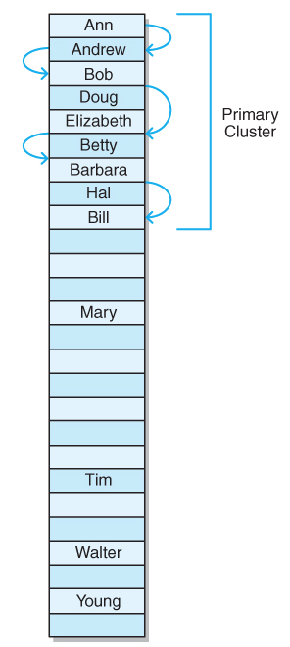
Resolving Collisions
Open addressing: Linear probing
If an element hashes to position p, and position p is occupied
Try (p + 1) % s, where s is the table size
If (p + 1) % s is occupied, try (p + 2) % s
Continue (p + 1) % s to (p + n) % s until either an open position if found or we return to position p
Linear probing tends to create clusters

Slide 11
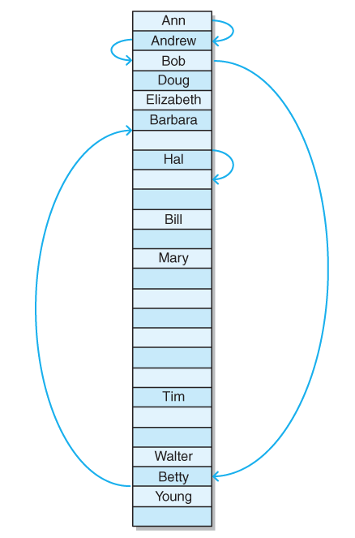
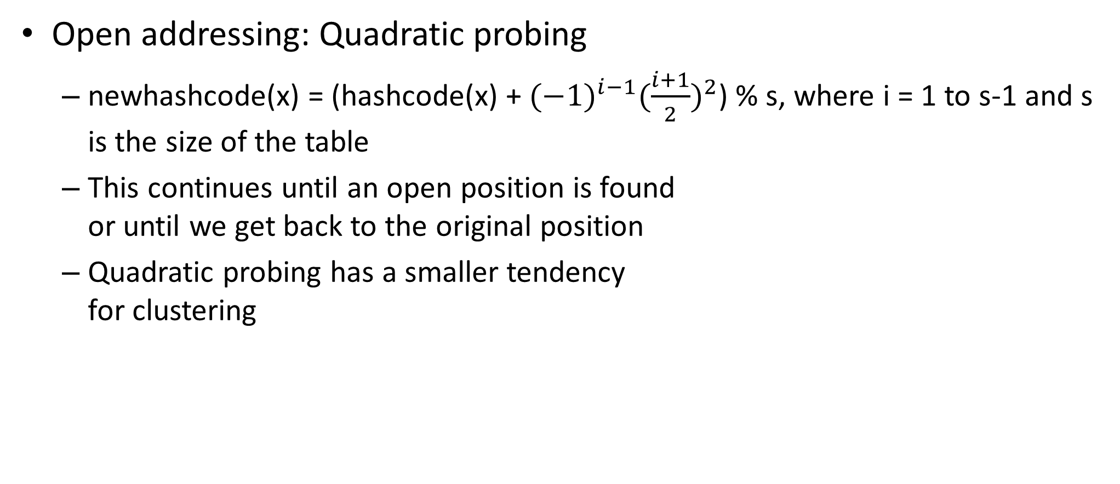
Resolving Collisions
Open addressing: Quadratic probing
newhashcode(x) = (hashcode(x) + ${(−1)}^{i−1}{(\frac{i+1}{2})}^{2}$) % s, where i = 1 to s-1 and s is the size of the table
This continues until an open position is found or until we get back to the original position
Quadratic probing has a smaller tendency for clustering

Slide 12
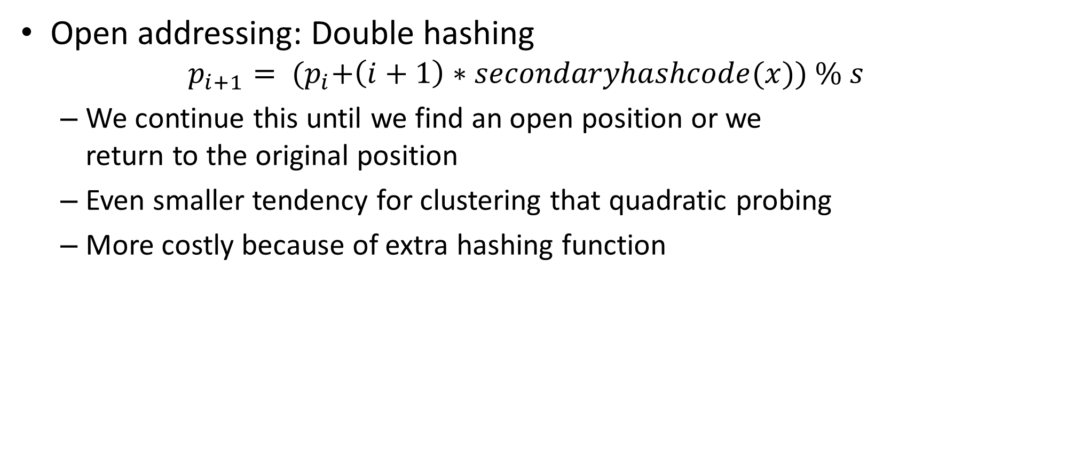
Resolving Collisions
Open addressing: Double hashing
$$p_{i+1}= {(p}_{i}+\left(i+1\right)∗secondaryhashcode(x)) \% s$$
We continue this until we find an open position or we return to the original position
Even smaller tendency for clustering that quadratic probing
More costly because of extra hashing function

Slide 13
Deleting Elements from a Hash Table
Chained
Array with overflow area
Case 1: One element
Case 2: Element in table with an element in overflow
Case 3: Element at end of overflow
Case 4: Element in middle of overflow
Case 5: Element not in list
Linked implementation
Remove the target element from the collection

Slide 14
Deleting Elements from a Hash Table
Open addressing
Mark the element as deleted but do not actually delete the element so that we can still follow to the next element
Positions marked as deleted are available for insertion
At a pre-determined deletion threshold, re-hash the table

